Slide 1
PART 3: Xamarin Workbooks, UI Inspector, Previewer, and Profiler
OPERATION: REMOTE RESUPPLY

Slide 2
Xamarin Workbooks
Documentation
Code
Apps or Emulators
Combine documentation with interactive code execution
Use standard Markdown (*.MD) notations
Written in C#
Workbooks can target Android, iOS, Mac, WPF, or Windows Console
Documentation
Code
Documentation
Code
Documentation
Notes:
Xamarin Workbooks is a cross-platform authoring tool providing a blend of documentation and code that is perfect for experimentation, learning, and creating guides and teaching aids, based on standard Markdown (*.MD) notations.
With Xamarin Workbooks you can create a rich, interactive workbook for Android, iOS, Mac, WPF, or the Windows Console, using C#

Slide 3
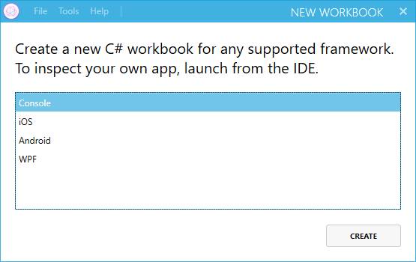
Creating Xamarin Workbooks
Text file with a *.workbook extension
Notes:
Workbook files are essentially Markdown files with a YAML header and contain formatted text and “code-fenced” C#.
The file extension for a Xamarin Workbook is “.workbook.” Since workbooks are markdown and human-readable, you can create a workbook with any text editor, however the Xamarin Workbooks app provides a robust interface for creating and edit workbooks, and so if the preferred method of creation.

Slide 4
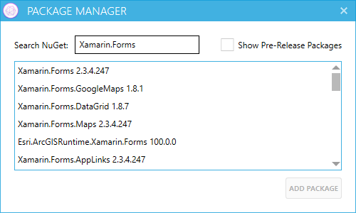
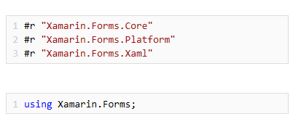
Integrating Workbooks with Xamarin Forms
Add the Xamarin.Forms via a NuGet Package
Add appropriate using statements
Get a reference to the “MainPage” property
Write C# code to interact with the page
var page =
Xamarin.Forms.Application.Current.MainPage as ContentPage;
Notes:
Although not required for creating workbooks, referencing appropriate NuGet packages is required for working with Xamarin.Forms, Xamarin.Android, and Xamarin.iOS integration.
The Xamarin Workbook app provides a simple mechanism for searching and adding NuGet packages to a workbook.
When the Xamarin.Forms package is installed for a workbook, the appropriate #r (require) directives are automatically added to a code cell. Additional using statements are optionally added to code cells as needed.
These examples, which come from Part #3, demonstrate the basic code necessary for integrating Xamarin Forms into a workbook.

Slide 5
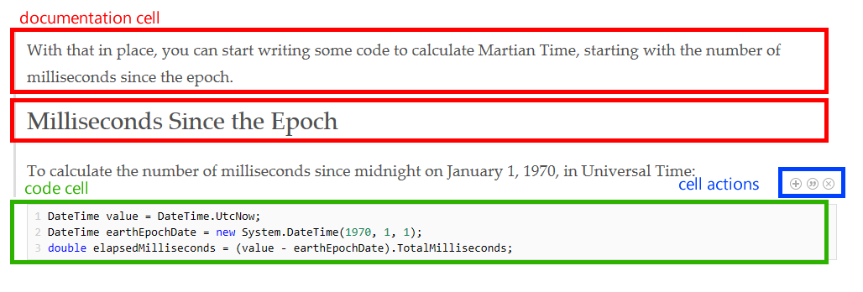
Authoring Xamarin Workbooks
Add documentation cells
Format documentation cell
Add code cells
Execute code cells “to current”
Execute all cells
Notes:
When authoring workbooks, creators work with two (2) types of cells:
Documentation cells
Code cells
All workbooks are a combination of these cell elements, and management of these elements (adding or removing cells) is provided via the cell actions panel, an “in context” toolbar available as a workbook is being authored.

Slide 6
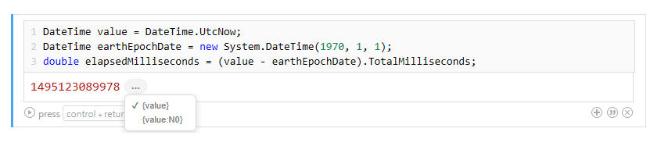
Working with Code Cells
Always written in C#
Executed via “Run” or keyboard
Can reference variables contained in previous code cells
Notes:
Code in a code cell is always written in C# and follows standard naming conventions just as if you were writing code in any C# scenario. Code cells can be executed simply by tapping the Run (arrow) icon or by pressing CTRL + RETURN on a keyboard, and can contain references to code found in previous code cells.
Formatting and display of code return values can be displayed in common formats directly in the code result pane.
This example, which comes from Part #3, displays the calculation of elapsed milliseconds since the commonly used “epoch date” of January 1, 1970.

Slide 7
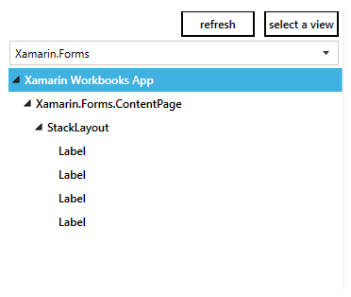
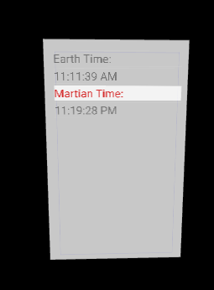
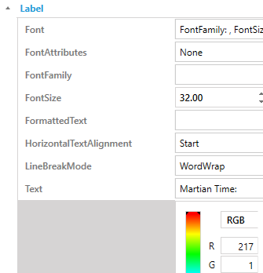
Xamarin UI Inspector
View in platform-specific mode or Xamarin Forms mode
3D rendering enables “layered” viewing
Not all properties are available for live editing
Notes:
The Xamarin Inspector, or UI Inspector, is a debugging and exploration tool for both Xamarin Workbooks and existing apps, allowing you to “inspect” your mobile apps and make changes to the UI live without having to recompile, including changes to scaling, rotation, and control element colors.
In a Xamarin Workbook, the UI Inspector is available via the View Inspector tab.
For Visual Studio Enterprise 2017 users, the UI Inspector is available when running under the context of the debugger via the “Inspect” button.

Slide 8
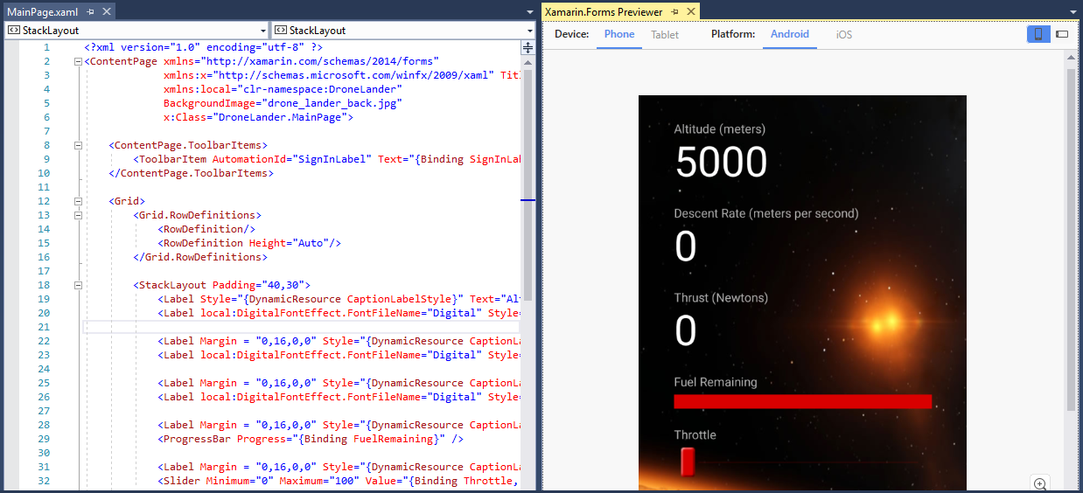
XAML Previewer
Notes:
The XAML Previewer for Xamarin.Forms (also referred to as the Xamarin.Forms Previewer) provides platform-specific renderings XAML-based pages for display while working with XAML code pages in Visual Studio 2017, and makes it simple to view controls and layouts based on generic phone and tablet form factors for both Android and iOS devices.
Edits and adjustments to XAML code reflect immediate in the Previewer, making it simple to tweaks control elements at design time, instead of requiring changes to be deployed to a device or emulator for viewing.
The XAML Previewer is also able to understand, interpret, and execute design-time data and binding values, providing an accurate “snapshot” of a user experience while designing a user interface.
This example, which comes from Part #3, demonstrates viewing both the XAML code editor and XAML Previewer side=-by-side in Visual Studio 2017.

Slide 9
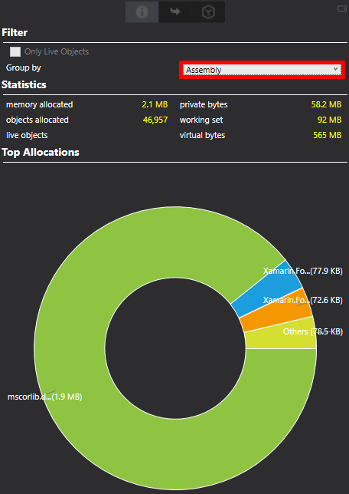
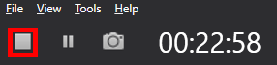
Xamarin Profiler
Only available in Visual Studio 2017 Enterprise
Instruments for:
Allocations
Time Profiler
Cycles
Call tree
Sampling
Notes:
The Xamarin Profiler (only available in Visual Studio 2017 Enterprise) integrates seamlessly with your existing Xamarin toolchain to collect information about your Xamarin apps.
The Xamarin Profiler makes it easy to find memory leaks, resolve performance bottlenecks, and add polish to your apps before distributing them to users.
The Profiler uses:
Allocations for tracking memory
Time Profiler for tracking performance
Cycle for tracking memory cycles

Slide 10
Lab Walkthrough
Xamarin Workbooks, UI Inspector, Previewer, and Profiler

